Slide 1

Marble Arch Paint Ltd.
School of Computer Engineering and Information Technology
Software Engineering Module
POS and Stock Control System

Slide 2
Presentation Layout
Business Domain
Business Model
Structured Analysis
Database Model
Project Introduction
Demo

Slide 3
Business Domain:
A DIY tools store (retailer)
Buy big quantities, sell small quantities
POS (Checkout)
Stock Control
Notes:
A DIY tools store (retailer) that sells paints, hand tools ,power tools
who purchase goods or products in large quantities from manufacturers directly or through a wholesale, and then sell smaller quantities to the consumer for a profit.
The company needs a POS (Point of sale), stock control software to computerize wt they do.
Point of sale (POS) or checkout is the place where a retail transaction is completed. It is the point at which a customer makes a payment to a merchant in exchange for goods or services.
Stock Control: controlling the goods and materials that a business holds for the ultimate purpose of resale.

Slide 4
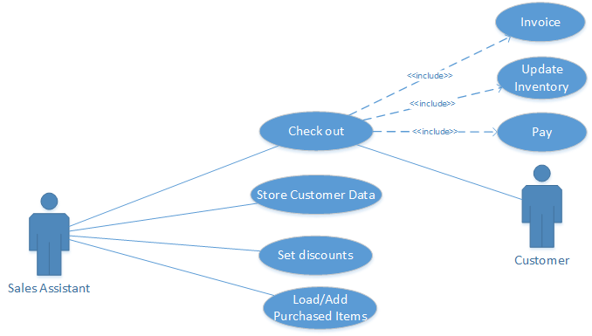
Business Model: POS
Notes:
. At the point of sale the salesperson would calculate the amount owing then issue a receipt for the transaction.
The subtotal and the total is calculated after discount if there is any.
Furthermore, there is the possibility to specify either a discount for each item individually (sub-discount) or total discount after the total price is calculated.
A bill/receipt is produced after every selling transaction specifying the details of the purchased items, the prices and the total.
All the users should be able to carry out the previously mentioned tasks in the new software.
Furthermore, the admin should be able to see profit and revenue reports or summary.

Slide 5
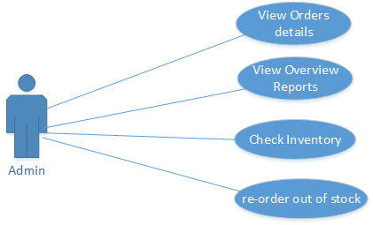
Business Model Stock Control
Notes:
The company keeps track of the items (ingoing/outgoing) with the details of each item ( Quantity, price, SKU, description …etc).
The company issues purchase orders whenever an item is about to run out. It also keeps track of all its purchased orders and vendors details list and change the stock items quantities respectively.

Slide 6
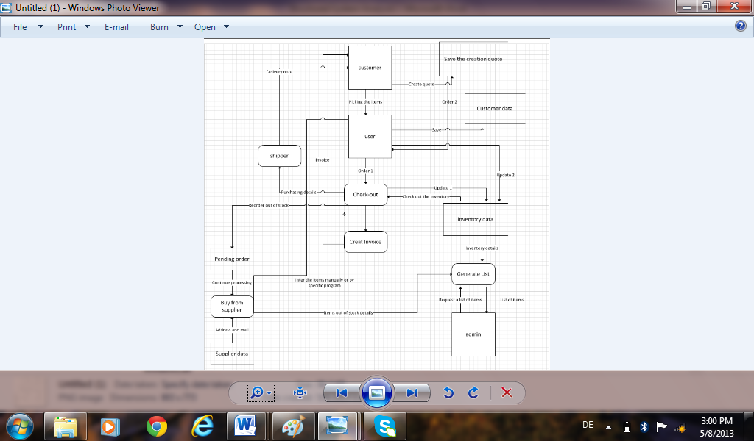
Structured Analysis

Slide 7
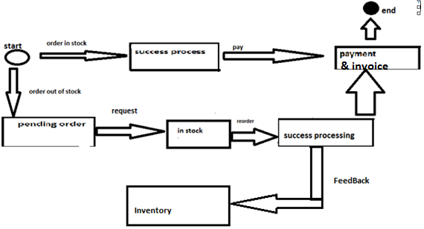
FSM

Slide 8
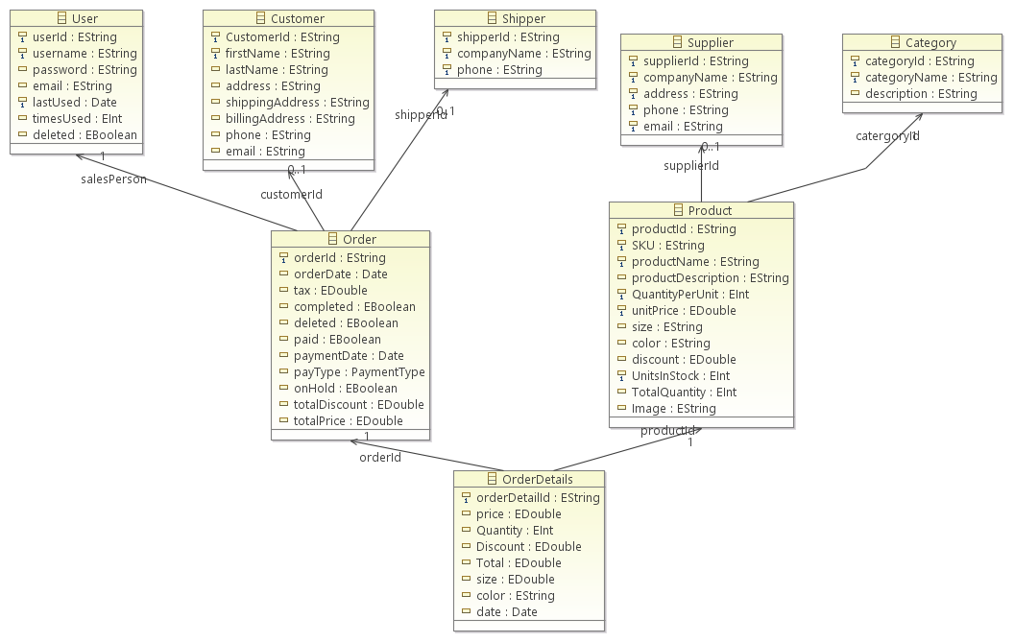
DB Model Class Diagram

Slide 9
Project
POS Part
Stock Control Part
Orders Part
Notes:
designed and developed to meet the needs of Marble Arch Paint Ltd. It consist of three main parts. The first one is the POS system which is dedicated to carry out the checkout process. The second one is the stock control system, which was developed to carry out the inventory storage control. The third one is the quotation system which stores customers quotes for a future reference and carry them out once the customer asks for that. Therefore, the project has the important views, each of which is dedicated for one of these parts.

Slide 10
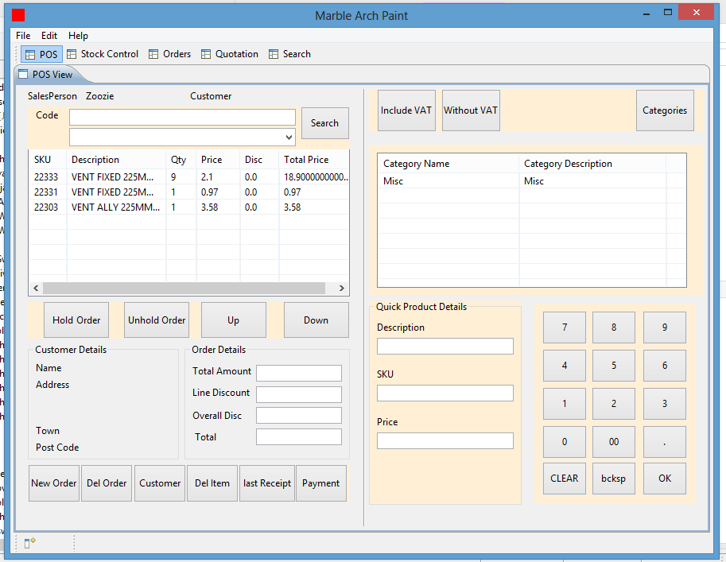
POS

Slide 11
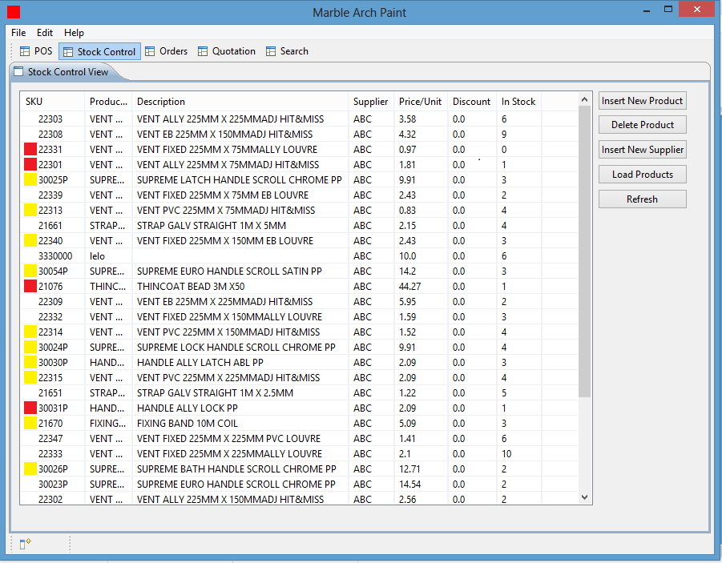
Stock Control

Slide 12
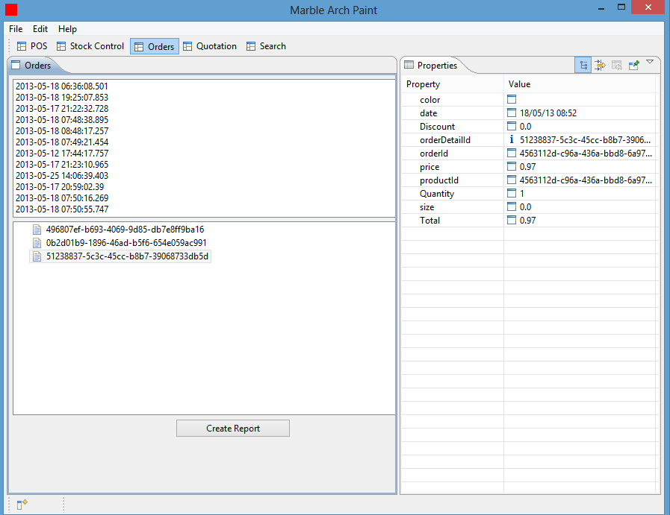
Orders

Slide 13
Future Direction
Implementing the quotation system
Implementing VAT option
Roles
Specific period report

